Slide 1

Operating systems
I/O Management, System Protection and Security
Venkatesh Prasad
Department of Computer Science

Slide 2
Operating systems
System Protection - Goals, Principles and Domain of Protection
Venkatesh Prasad
Department of Computer Science
Notes:
Discuss the goals and principles of protection in a modern computer system
Explain how protection domains combined with an access matrix are used to specify the resources a process may access

Slide 3
OPERATING SYSTEMS
Slides Credits for all PPTs of this course
The slides/diagrams in this course are an adaptation, combination, and enhancement of material from the following resources and persons:
Slides of Operating System Concepts, Abraham Silberschatz, Peter Baer Galvin, Greg Gagne - 9th edition 2013 and some slides from 10th edition 2018
Some conceptual text and diagram from Operating Systems - Internals and Design Principles, William Stallings, 9th edition 2018
Some presentation transcripts from A. Frank – P. Weisberg
Some conceptual text from Operating Systems: Three Easy Pieces, Remzi Arpaci-Dusseau, Andrea Arpaci Dusseau

Slide 4
OPERATING SYSTEMS
Goals of Protection
In one protection model, computer consists of a collection of objects, hardware or software
Each object has a unique name and can be accessed through a well-defined set of operations
Protection problem - ensure that each object is accessed correctly and only by those processes that are allowed to do so
Protection provides a mechanism for the enforcement of the policies governing resource use
Some policies are fixed in the design of the system, while others are formulated by the management of a system and by the individual users as well (to protect their own files and programs).

Slide 5
OPERATING SYSTEMS
Principles of Protection
Guiding principle – principle of least privilege
Programs, users and systems should be given just enough privileges to perform their tasks
Limits damage if entity has a bug, gets abused
OS follows this principle for its features, programs, system calls and data structures
Can be static (during life of system, during life of process)
Or dynamic (changed by process as needed) – domain switching, privilege escalation
“Need to know” a similar concept regarding access to data
Examples: when a process invokes a procedure or a compiler

Slide 6
OPERATING SYSTEMS
Principles of Protection (Cont.)
Must consider “grain” aspect
Rough-grained privilege management easier, simpler, but least privilege now done in large chunks
For example, traditional Unix processes either have abilities of the associated user, or of root
Fine-grained management more complex, more overhead, but more protective
Provide/disable privileges as needed
Create audit trail for privileged function access
File ACL lists, RBAC
Domain can be user, process, procedure

Slide 7
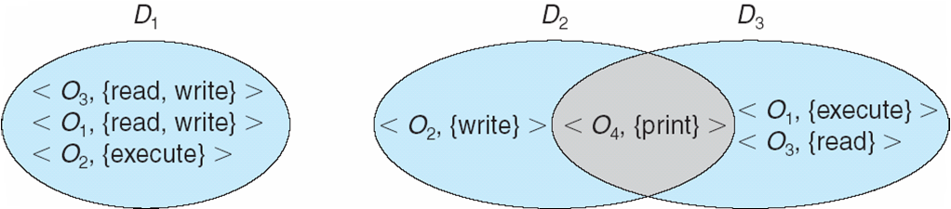
OPERATING SYSTEMS
Domain Structure
Each domain defines a set of objects and the types of operations that may be invoked on each object
Domain can be realized as user, process and procedure
Access right is the ability to execute an operation on an object
Access-right = <object-name, rights-set> where rights-set is a subset of all valid operations that can be performed on the object
Domain = set of access-rights
Domains may share access rights.
System with 3 protected domains
Notes:
The access right <O4, {print}> is shared by D2 and D3, implying that a process executing in either of these two domains can
print object O4. Note that a process must be executing in domain D1 to read
and write object O1, while only processes in domain D3 may execute object O1.

Slide 8
OPERATING SYSTEMS
Domain Implementation (UNIX)
Domain = user-id
Domain switch accomplished via file system
Each file has associated with it a domain bit (setuid bit)
When file is executed and setuid = on, then user-id is set to owner of the file being executed
When execution completes user-id is reset
Domain switch accomplished via passwords
su command temporarily switches to another user’s domain when other domain’s password provided
Domain switching via commands
sudo command prefix executes specified command in another domain (if original domain has privilege or password given)

Slide 9
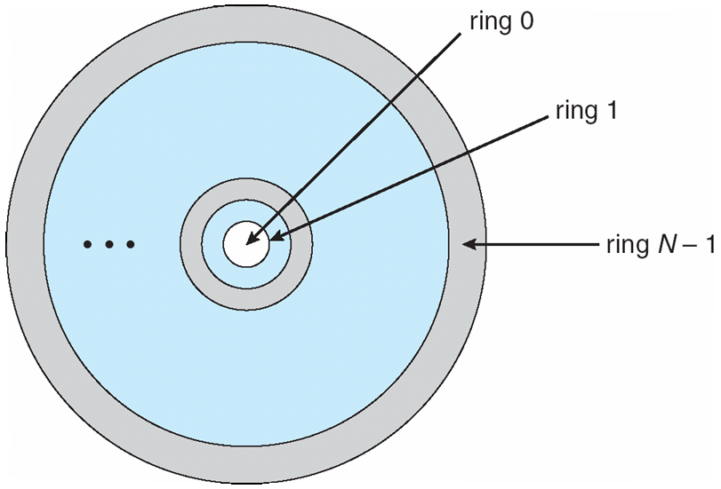
OPERATING SYSTEMS
Domain Implementation (MULTICS)
Rings are numbered from 0 to 7
Ring 0 is most privileged
Let D_{i} and D_{j} be any two domain rings
If j < i, then D_{i} is a subset of D_{j}
Multiplexed Information and Computing Service
- was a cooperative project led by MIT along with General Electric and Bell Labs.
was started in 1964 and has influenced all modern operating systems from microcomputers to mainframes
-was the first major OS to be designed as a secure system
- had hardware support for ring-oriented security
Notes:
A process executing in domain Dj has more privileges than does a process executing in domain Di.
A process executing in domain D0 has the most privileges. If only two rings exist, this
scheme is equivalent to the monitor–user mode of execution, where monitor
mode corresponds to D0 and user mode corresponds to D1.

Slide 10
OPERATING SYSTEMS
Multics Benefits and Limits
Ring / hierarchical structure provided more than the basic kernel / user or root / normal user design
Fairly complex -> more overhead
But does not allow strict need-to-know principle
Object accessible in D_{j} but not in D_{i}, then j must be < i
But then every segment accessible in D_{i} is also accessible in D_{j}
Notes:
Reference: https://multicians.org/multics-data-security.html

Slide 11
OPERATING SYSTEMS
Multics Miscellaneous
Structure of the Multics segment descriptor word (SDW) contains:
Segment’s address and length,
access indicators including ring brackets (i.e., R1, R2, R3), the process’s ACL for the segment (i.e., the RWE bits), and the number of gates for the segment.
Address | Length | R1 | R2 | R3 | R | W | E | Gate
Access Indicator
Notes:
Ref: http://www.cse.psu.edu/~trj1/cse443-s12/docs/ch3.pdf

Slide 12
OPERATING SYSTEMS
Multics Miscellaneous (Cont.)
Ring bracket identifies the ring(s) from which the specified access mode is permitted.
Also, protection domain transition rules are defined by ring brackets
All code, data, I/O devices, etc. that may be accessed by a process are stored as segments.
A segment’s access bracket defines the ranges of rings that can read and write to a segment.
An Access bracket is specified by a range of rings (r1, r2) where r1 ≤ r2 (i.e.,r1 is more privileged than r2).
Limit – Allows processes with limited access rights to call procedures in lower rings that have more access rights, but only in a carefully controlled manner.
List of gates – Identifies the entry points or gates at which the segments may be called.

Slide 13
OPERATING SYSTEMS
Multics Miscellaneous (Cont.)
Suppose a process is running in ring r, then the access rights of that process to a segment with an access bracket of (r1, r2) are determined by:
If r < r1, then the process can read and write to the segment.
If r1 ≤ r ≤ r2, then the process can read the segment only.
If r2 < r, then the process has no access to the segment.
Such a policy ensures that lower rings (i.e., more privileged) have strictly greater access to segments than the higher rings.

Slide 14
OPERATING SYSTEMS
Multics Miscellaneous (Cont.)
Multics also uses rings to control the invocation of code segments.
A second access specification, the call bracket, is used along with the access bracket to determine how a process in ring r invokes a code segment.
The call brackets not only define execute privilege based on the process’s current protection ring, but they also define transition rules describing the requirements for protection domain transition (e.g., if authorized by all gates) and the resultant ring number for the executing code.
Call brackets are the only means of describing transition state in the Multics system.

Slide 15
OPERATING SYSTEMS
Multics Miscellaneous (Cont.)
The call bracket is (r2, r3), where r2 is same r2 as in the access bracket and r2 ≤ r3.
If a process at ring r tries to invoke a code segment with an access bracket of (r1, r2) and a call bracket of (r2, r3), the following cases are possible:
• If r < r1, then the process can execute the code segment, but there is a ring transition from r to a lower privileged ring r1 ≤ r’ ≤ r2 specified by the segment (typically, r1 == r2, so the transition is obvious).
• If r1 ≤ r ≤ r2, then the process invokes the code segment in its current ring r (i.e., no ring transition).
• If r2 ≤ r ≤ r3, then the process can execute the code segment, there is a ring transition from r to the higher privileged ring r’ if authorized by the gates in the code segment’s SDW.
• If r3 < r, then the process cannot invoke the code segment.

Slide 16

THANK YOU
Venkatesh Prasad
Department of Computer Science Engineering
venkateshprasad@pes.edu

